Slide 1
Sooke Homelessness Coalition Community Action Team
November 24, 2023

Slide 2
*
“The SHC brings together multiple individuals and service agencies to address the prevention and resolution of homelessness in the Sooke region.
It provides support, advice and advocacy to and for the Sooke Shelter Society, an independent registered charity that is responsible for the networking, coordination and delivery of homelessness and at-risk homelessness-related services in the Sooke region.”
From the SHC Terms of Reference, updated annually

Slide 3
*
SHC Participants have included …
- Alliance to End Homelessness in Greater Victoria
- Sooke Shelter Society
- T’Sou-ke First Nation
- Pacheedaht First Nation
- District of Sooke Bylaw Services
- Mayor Tait/Council appointee
- Sooke RCMP
- Sooke Fire
- CRD Reaching Home Program
- BC Housing
Challenge: Declining attendance at SHC meetings now that the Hope Centre is operational.

Slide 4
Context & Timeline
Sooke is officially a Compassionate Community – one of 110 world-wide
This recognition (2019) by Charter for Compassion International is based on current undertakings by Sooke individuals and organizations atop a long history of local volunteerism, care and community kindness towards our most vulnerable citizens.
Local volunteer groups, churches and non-profit organizations have worked with the local homeless for decades, i.e. the Sooke Crisis Centre, Sooke Food Bank, Sooke Family Resource Society, Anglican Church and Baptist Church breakfast/lunch programs.

Slide 5
*
2016 - The Sooke Region Health Summit, hosted by SRCHN and Mayor Maja Tait’s Primary Health Care Working Group, identified community gaps in health and special-needs services, social and recreational activities, and healthy food accessibility.
- A year-round homeless shelter for the unhoused and support services for those at-risk of homelessness was prominent among local needs.
2017 - Sooke Shelter Society founded with a mission of ensuring that all people in the Sooke area have access to safe, affordable, and long-term housing as well as holistic health support services

Slide 6
*
2019 - Sooke Region Communities Health Network and the District of Sooke form the Sooke Homelessness Coalition
Spring 2021 - Hope Centre purchased by BC Housing
2021/22 – SHC Strategic Plan development -50+ community members representing a dozen organizations
2022 – Sooke Shelter Society takes over management of the Hope Centre

Slide 7
Hope Centre Overview
Purchased by BC Housing in February 2021 to provide 33 units of transitional housing for unhoused individuals in Sooke.
Addiction, mental health and other support services available on-site through the CRD’s Reaching Home Program
Building managed by the Sooke Shelter Society
Ground floor support-services hub now being constructed by BC Housing as shelter residents move into upstairs apartments
New BC Housing apartments on Sooke’s east-side will include 49 shelter-rate subsidized units

Slide 8
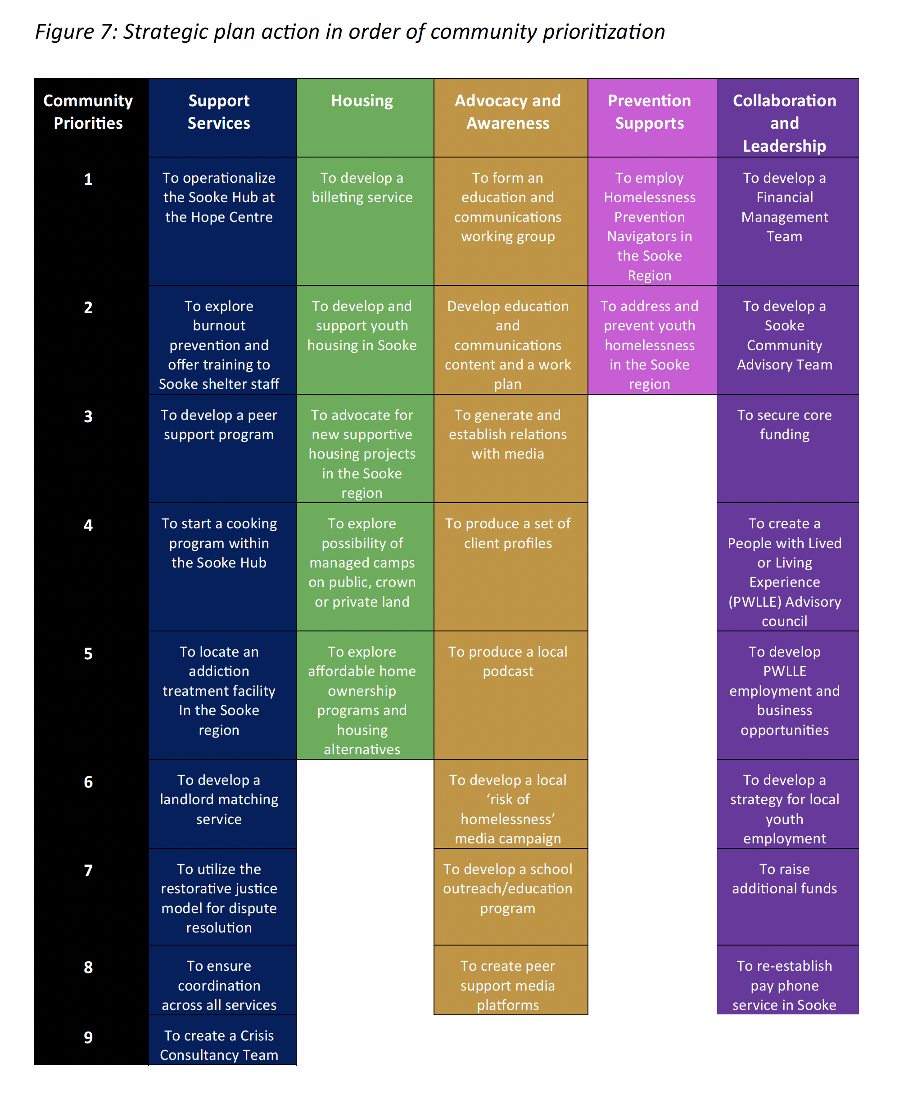

Slide 9
Strategic Plan Priorities Actions Continuing and Underway
Sooke Homelessness Coalition
Advocacy for stable, long-term funding
Stakeholder engagement via regular meetings
Create Sooke Community Advisory Team
Addiction treatment centre in the Sooke region
RV/Homeowner Matchmaking pilot project
Sooke Shelter Society
Ongoing day-to-day operations and out-reach
Develop a Financial Management Team
Operationalize the Sooke Hub at the Hope Centre
Fundraising Campaigns
Advocacy for stable, long-term funding

Slide 10
Leading unrealized Priority Actions
To form an Education and Communications Working Group
Address and prevent youth homelessness in Sooke region
To create a Lived/Living Experience Advisory Council
Homelessness navigators for Sooke region

Slide 11
Sooke Community Advisory Team - Terms of Reference based on the BC Housing template -- created, modified and approved by the SHC - BC Housing twice attempted unsuccessfully to launch its advisory group; recognizes SHC serves this purpose - SHC decided independently to form a CAT - First monthly meeting on Nov. 24, 2023

Slide 12
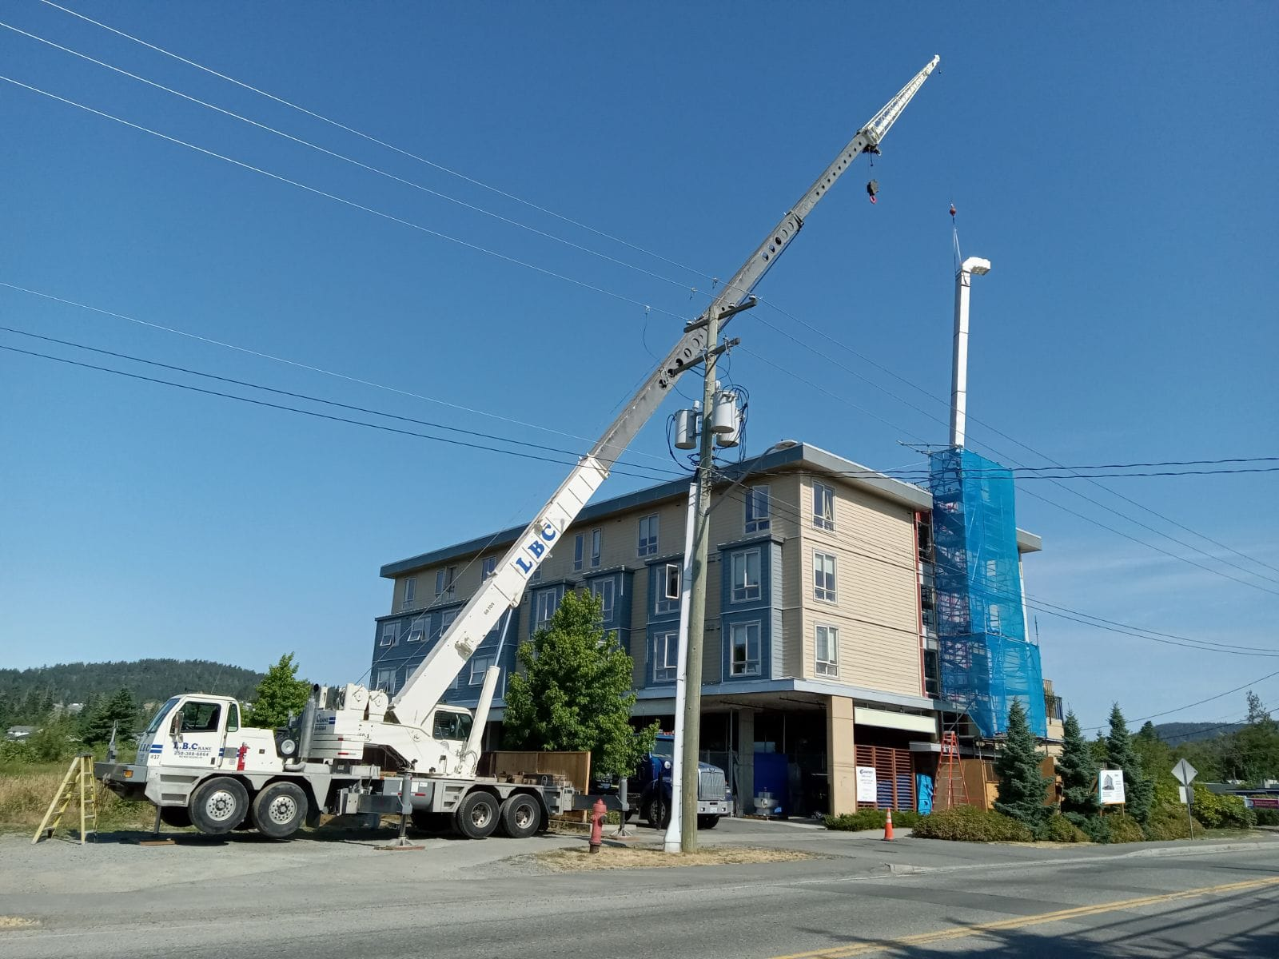
Operationalize the Sooke Hub at Hummingbird Place (formerly the Hope Centre) Near competition of a ground-floor service hub that will include six shelter beds, support-worker office space, commercial kitchen, common area, showers, laundry facilities. Serving Hummingbird residents and all those at-risk of homelessness in the community.

Slide 13
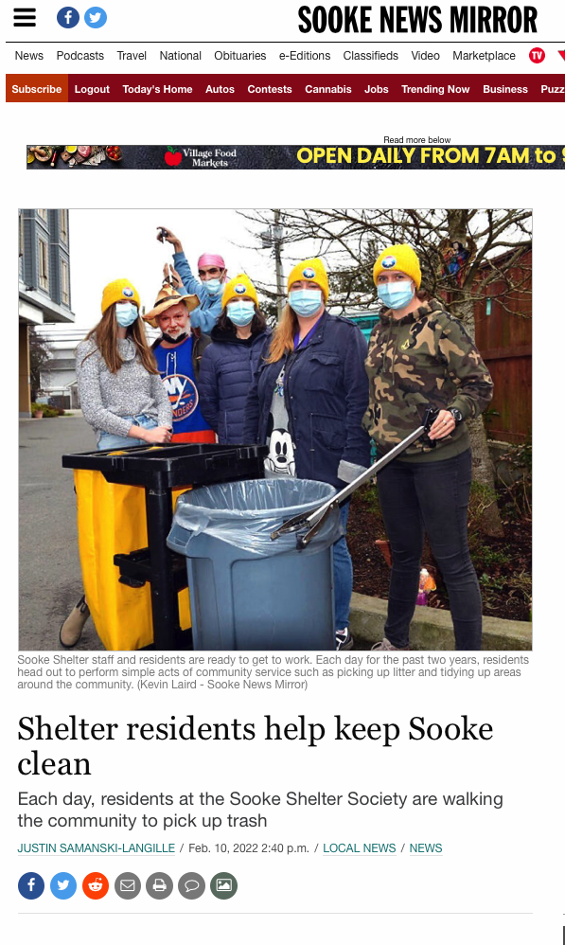
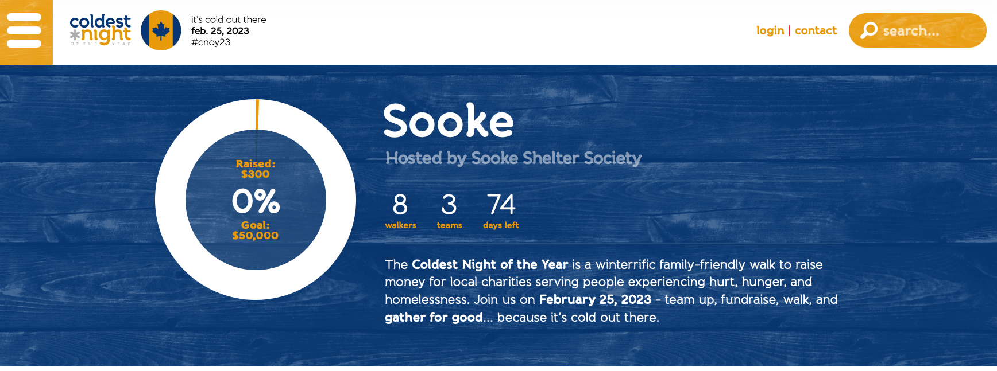
Ongoing: Community Education & Engagement
Coldest Night of the Year – Saturday, Feb. 24, 2024
Strat Plan Communications Priorities
Website
Media Relations
Social Media
Talking Circles
Lived Experience Spokespeople
Face2Face With Stigma Workshops

Slide 14
Advocacy

Slide 16
*

Slide 17
Sooke Food Bank out-reach to Sooke Shelter

Slide 18
Community at Hummingbird Place

Slide 19
*

Slide 20
*

Slide 21
Recently on Facebook

Slide 22
*

